Slide 1
Project Proposal
Item based Collaborative filtering with User Features
Presented by Krishna Sirisha

Slide 2
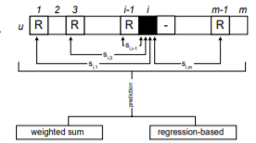
Existing Method of Item Based Collaborative Filtering
Creates a user-item matrix with the ratings listed in the dataset
Computes the item-item similarity
Predicted rating is calculated with the similarity measure
Recommendations are done to the user based on the predictions calculated
User/ Item | Item1 | Item2 | Item3
User1 | 4 | ? | 3
User2 | 5 | 4 | 3
User3 | ? | 2 | 1
User/ Item | Item1 | Item2 | Item3
User1 | 4 | ? | 3
User2 | 5 | 4 | 3
User3 | ? | 2 | 1

Slide 3
Issue with the existing method
Takes only the item-item similarity into account
Does not consider the user features
Prediction quality might be low in some cases where predictions are done without considering the user features
Though achieves good performance, likely to present less quality recommendations

Slide 4
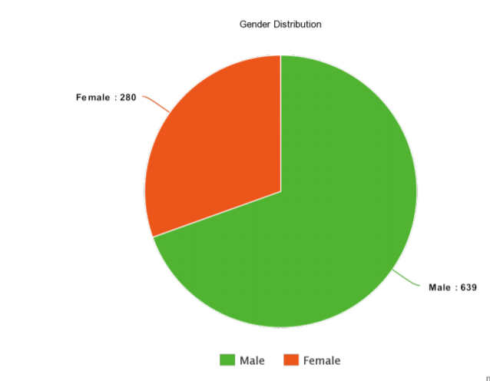
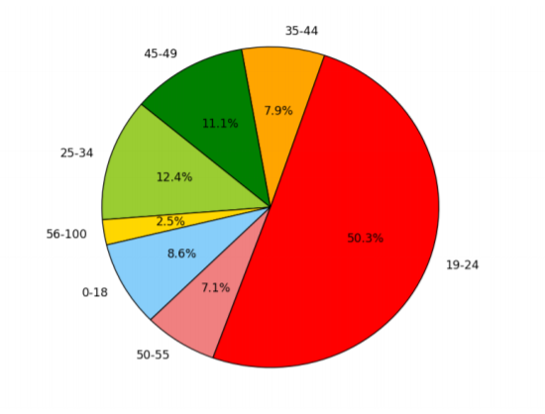
Example of the User Features
Consider the Movie Lens dataset which has the user features like Age, Gender, Occupation etc.

Slide 5
User Features for Recommendation
User Features play an important role for making effective recommendations
Knowing user profile helps in increasing the quality of recommended items
The present model takes into account the item similarities without user features
Consider a case where there is a dataset with 80% of users are of age 40-60, so the similar ratings on the movies would make items similar which effects the remaining 20% of users of age 15-25.
As a result, the users who are of different age see recommendations that are not accurate to them

Slide 6
Different approach towards the item based collaborative filtering
This approach is applying the item based collaborative filtering after grouping the users
Users of similar age category and gender are grouped together
The item based collaborative filtering is then applied to compute the predictions and generate recommendations for the user within the group.
Age 18-35
Gender: Male
Group1
Age 36-55
Gender: Male
Group3
Age 56-80
Gender: Male
Group5
Age 18-35
Gender: Female
Group2
Age 36-55
Gender: Female
Group4

Slide 7

Load dataset with user features and items
Group users based on user features
G1
G2
…..
G6
G7
…..
Gn
IBCF
IBCF
IBCF
IBCF
IBCF
Prediction
Recommendation

Slide 8
Quality of Recommendations
Through this approach the quality of recommendations is likely to be increased as the user features are taken into account
In this project, the quality would be determined by calculating the MAE (Mean Absolute Error) of the predicted ratings and the actual ratings that are rated by the user
Also compares the quality with the recommendation generated by applying the item based algorithm in order to check the better method.

Slide 9
Performance of the new approach
There would not be a significant difference in the performance because this approach also calculates the item-item similarities offline
Though there would be multiple user-item matrices, since the number of users would decrease depending on the group, the performance would not be decreased
Computation of ratings would decrease and hence would result in a fast system

Slide 10
Project Details
The Movie Lens dataset is considered for the experiment to generate movie recommendations for the users
Features like Age, Gender are considered
First, the item based collaborative filtering is executed and the recommendations are recorded
The new approach is implemented on the dataset and the predicted values are computed
The predicted values are compared with Item based approach as well as the actual user stated values
Corresponding MAE values are computed
Project would be implemented in python

Slide 11
Extensions to the Project Proposed
More features with more groups
Testing the approach with different data sets
Combining groups if there are less number of users in the group with the help of threshold value
Effect of quality with different threshold values

Slide 12
Questions

